Slide 1
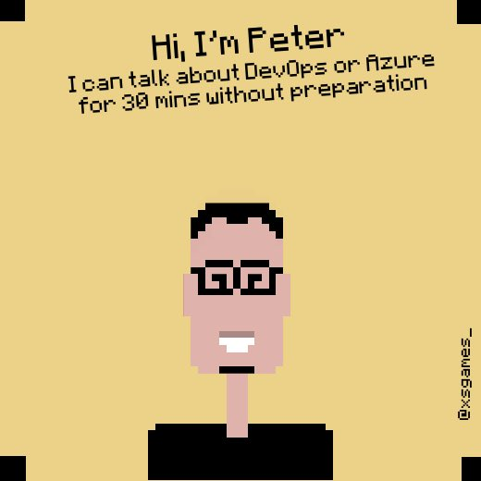
Azure DevSecOps
as an approach to building and deploying secure applications… by "shifting left"
Email: petender@microsoft.com Twitter: @pdtit Blog: https://aka.ms/pdtit

Slide 2
What will be covered
DevOps
Shift left mentality
DEVSECOPS tooling
DEMOS
Q & A

Slide 3
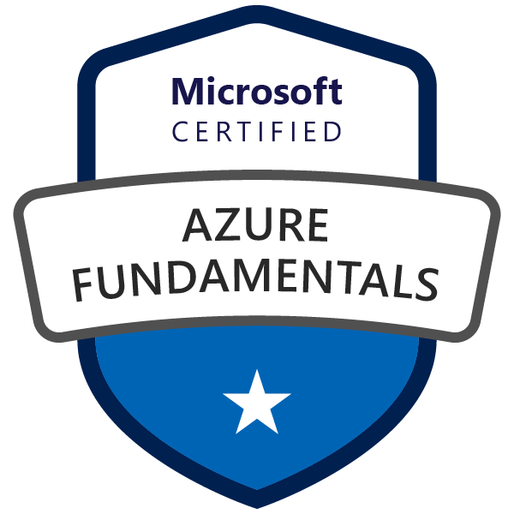
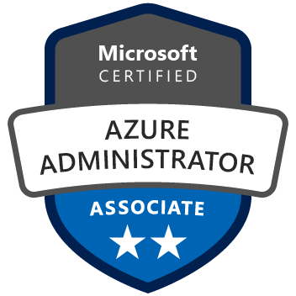
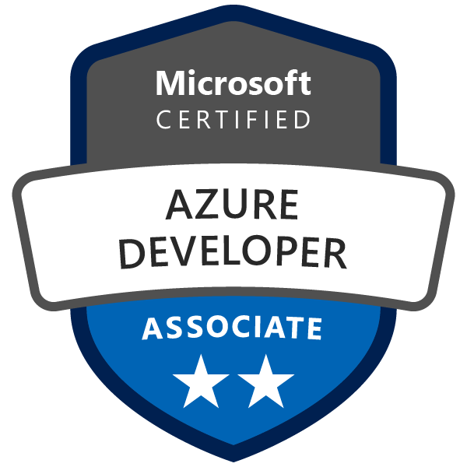
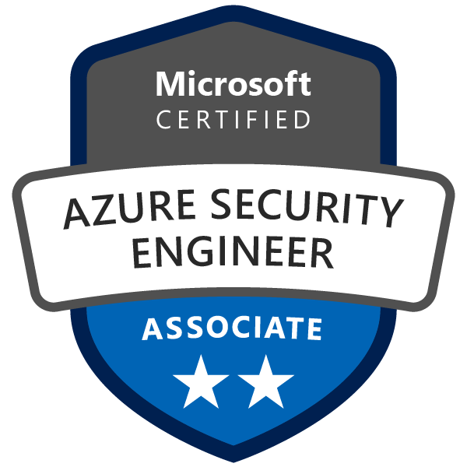
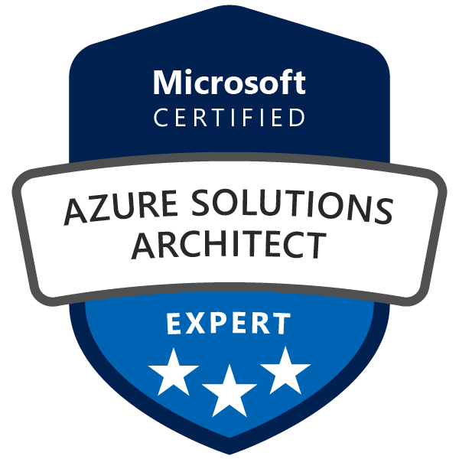
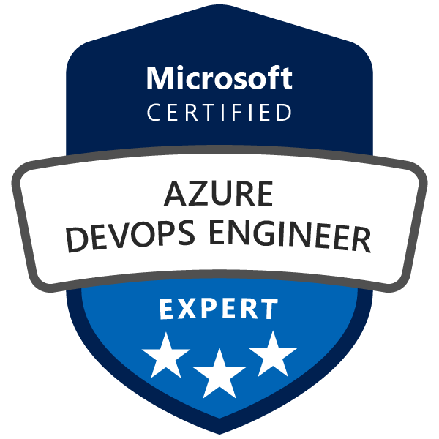
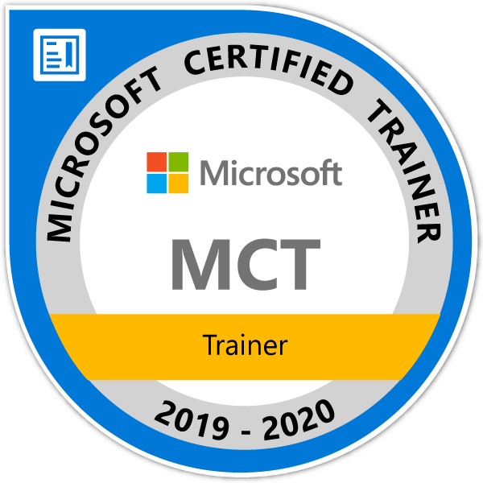

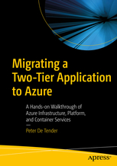
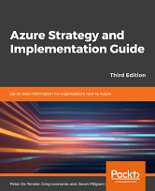
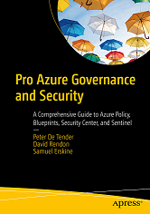
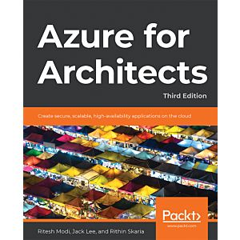
Peter De Tender
Azure Technical Trainer | DevOps Cloud Advocacy v-team Member
+25 years background in Microsoft Technologies
+12 years MCT, Former Azure MVP (5y)
Last 8 years 100% focus on Azure
Technical writer, book author and technical blogger
HashiCorp Ambassador 2020-2022
“...Bring me an audience, I give them Azure knowledge in return...”
{
Email: petender@microsoft.com
Twitter: @pdtit
Blog: https://www.007FFFLearning.com
}

Slide 4
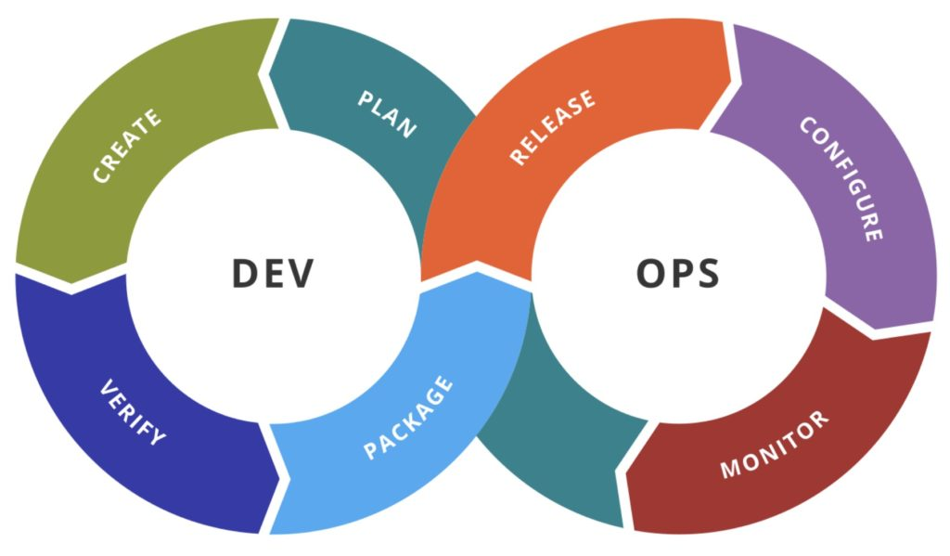
Concepts of DevOps
Microsoft’s Definition:
“…The Union of People, Processes and Products, to enable continuous delivery of value to our end users…”

Slide 5
Concepts of DevOps
Peter’s Definition:
“…Integrating a culture of continuously delivering value to your end users, based on team collaboration and workload automation…”
60% - Culture
40% - Tools

Slide 6






Automate Everything
DEV
VALIDATE
PACKAGE
RUN
OPERATE
Automate Everything!!

Slide 7
Secure Everything
DEV
VALIDATE
PACKAGE
RUN
OPERATE
Threat Modeling
Secure Coding Standards
Credentials & Secrets management
Peer Review
Code Analysis
Credentials & Secrets management
Approvals
Unit Testing
Container Vulnerability Scanning
Secured IaC
Secured Containers
Quality Gates
Cloud Configuration
Security & Pen-testing
Cloud Platform Security
RBAC permissions model
Credentials & Secrets management
Security Monitoring
Threat Detection
Mitigation

Slide 8

Secure Everything – by shifting left
DEV
VALIDATE
PACKAGE
RUN
OPERATE
Threat Modeling
Secure Coding Standards
Credentials & Secrets management
Peer Review
Code Analysis
Credentials & Secrets management
Approvals
Unit Testing
Container Vulnerability Scanning
Secured IaC
Secured Containers
Quality Gates
Cloud Configuration
Security & Pen-testing
Cloud Platform Security
RBAC permissions model
Credentials & Secrets management
Security Monitoring
Threat Detection
Mitigation

Slide 9
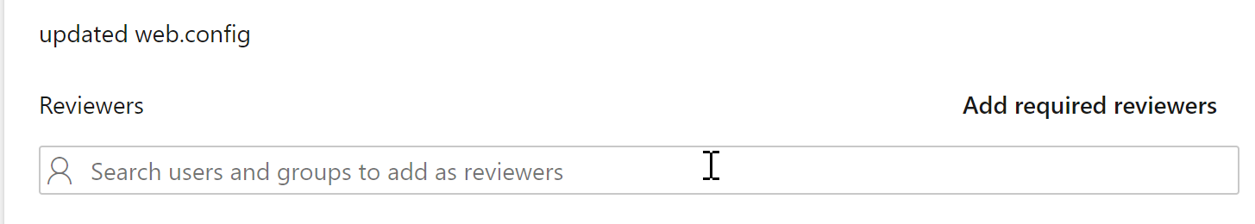
Secure Everything – by shifting left
Microsoft Threat Modeling Tool
Approvals for Pull Requests
ADO Security Scanner
https://aka.ms/adoscanner.

Slide 10
Demo
Microsoft threat modeling
Approvals & Pull requests
Ado scanner
Notes:
Demo Scenarios
Approvals & Pull Requests
From ADO PU Project / Settings / Repositories / select a specific branch petender-updates / settings – approvers
Open the source code folder c:\partsunlimited in VSCode, edit a file and run a commit + push
Create a new Pull Request and show the reviewers field
ADO Security Scanner
Open DevOps / Parts Unlimited / PU-ASPNet-Classic Pipeline, and show the ADO Security Scanner Task
Run the pipeline, or open an already completed job + show details of scanning
From dashboards,

Slide 11
Secure Everything – by shifting left
Code Analysis
Credentials & Secrets management
Container Vulnerability Scanning

Slide 12
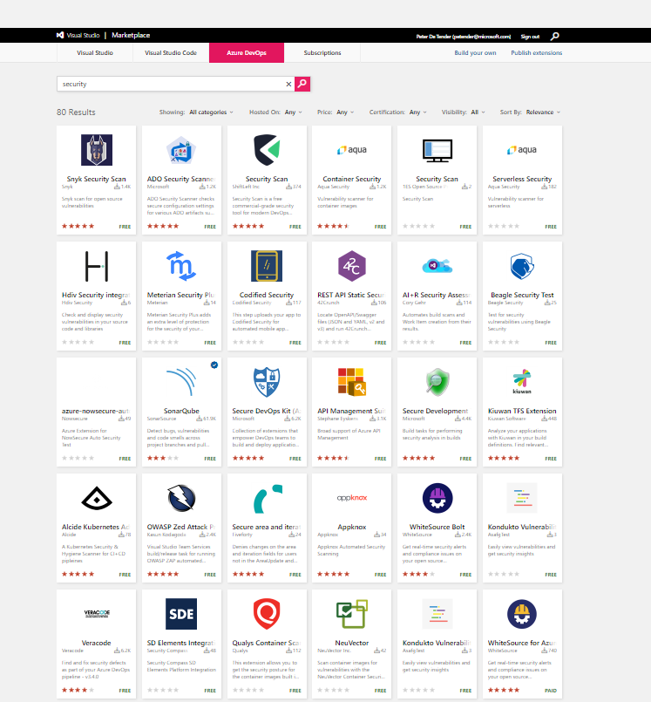
Demo
Code Analysis
Credentials & Secrets Management
Notes:
Demo Scenarios
Code Analysis
Open marketplace.visualstudio.com
Search for security – 80 different extensions that do something with security
Select WhiteSource Bolt – core feature is scanning for open source licensing dependencies, security vulnerabilities, software bugs,…
Select ADO Pipelines / WhiteSource Bolt / Describe the output of the details
Select Pipelines – details – pick SonarCloud + open sonarcloud.io
Go to owasp.org, discuss the secured analysis options they offer + share it’s the team behind WAF too
Credentials & Secrets Management
Show link from GitHub Advanced Security + keyvault integration for variables
Open KV Project, show library to interact variables from Keyvault
Show release pipeline, where there is a task to integrate KV and read out information

Slide 13
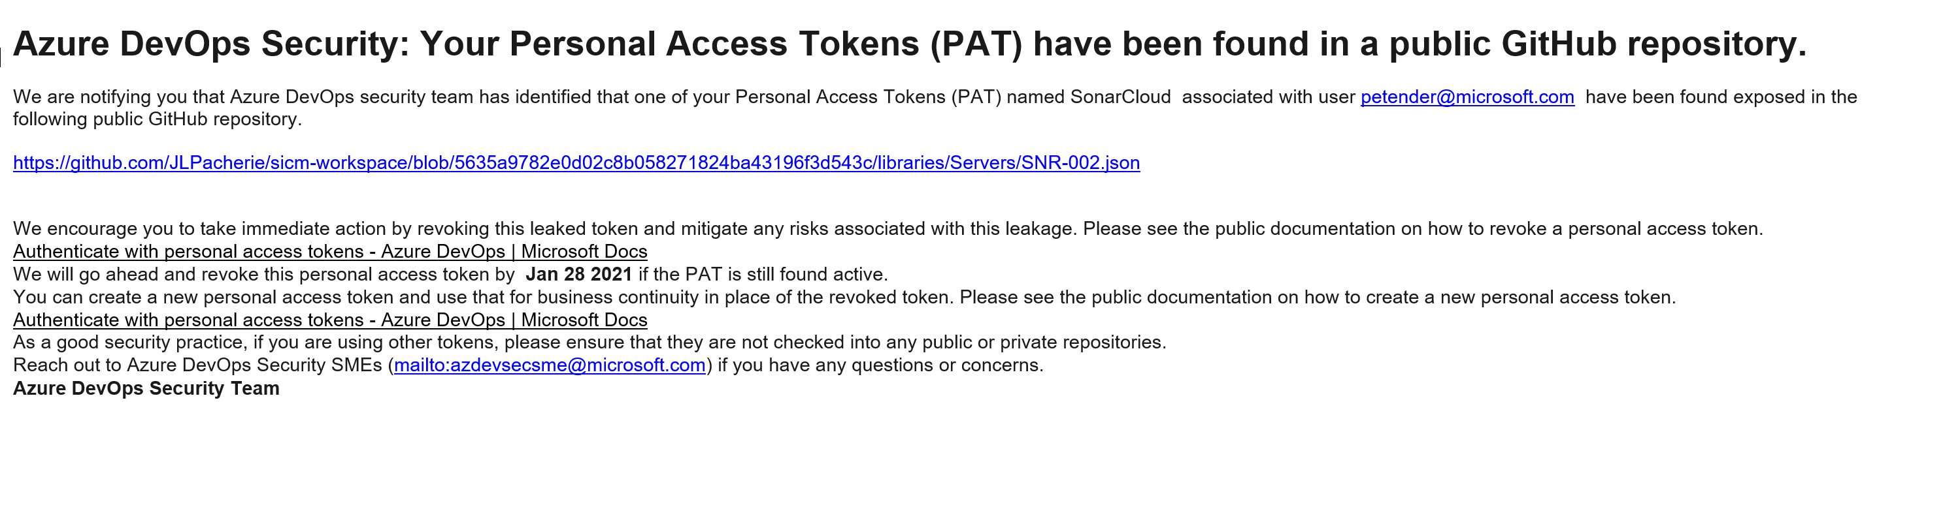

Slide 14
Secure Everything – by shifting left
Some Container Vulnerability Scanning Solutions (No preference!!)
AquaSec (https://www.aquasec.com/products/container-vulnerability-scanning/)
Qualys (https://www.qualys.com/apps/container-security/)
Clair (https://github.com/quay/clair)
Anchore (https://anchore.com/opensource/)
Docker Bench Security (https://github.com/docker/docker-bench-security)
Snyk (https://snyk.io)
And so many other ones ☺

Slide 15
Demo
Container Vulnerability Scanning
Notes:
Demo Scenarios
Container Vulnerability Scanning
Open Marketplace – show Qualys
Azure Portal – Security Center – Qualys integration for ACR
Show Pipeline setup for AKS project – Qualys as part of your CI/CD pipeline

Slide 16
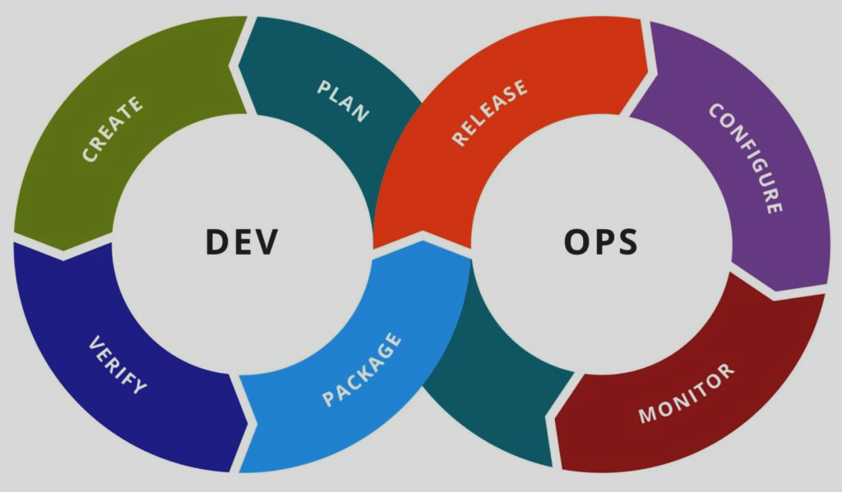
Concepts of DevSecOps
Peter’s Definition:
“…Developing a culture of delivering value to your end users, relying on team collaboration, workload automation and end-to-end security integration…”
SECURITY
SECURITY
SECURITY
SECURITY
SECURITY
SECURITY
SECURITY
SECURITY
SECURITY
SECURITY

Slide 17
What we covered
DevOps
Shift left mentality
DEVSECOPS tooling
DEMOS
Q & A

Slide 18

Thank you
petender@microsoft.com
https://twitter.com/pdtit
http://aka.ms/pdtit

